Slide 1

Empowering Staff & Patients to Lead Transformational Change
Sheinaz Stansfield: Practice Manager Oxford Terrace and Rawling Road Medical Group
Development Advisor: NHSE Sustainable Improvement Team
Twitter: @Sheinazs
Email: Sheinaz.stansfield1@nhs.net
Notes:
Practice manager career move – function at a high level whilst beeeing completely rooted to the ground amongst the people
Every day make a difference
quality accounts identified access, premises and workforce
Shortly after that claire gerada – andrew smith lecture access, premises and workforce – realisation no one was going to do it for us – we had to be brave, and bold to do it for ourselves
and do qi development programme – which help us implement the 10th high impact change to develop qui skills
We then used the qi skills to incrementally implement all of the 10 high actions over a period of 4years
Share some of those experiences today
Managing demand though care navigation and social prescribing
Extending the practice team – around pt need not 10 min gp appointmsnt
Supported self help

Slide 2
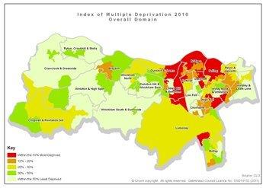
Oxford Terrace & Rawling Road Medical Group
Merger/Two sites
15.200 Patients
2500 high admission risk
All long term conditions
Hospital stay longer
Deaths earlier etc etc
High Dementia Prevalence
PMS
8 Care Homes
Research Ready
Training
Culture of Continuous Quality Improvement
“Passionate about Complex care”

Slide 3

GPFV: 10 High Impact Actions OTRR-MG Journey
QI skills
Personal Productivity
New Consultation Types
Developing the Team
Care Navigation
Partnership Working
Social Prescribing
Improving Workflows
Supported Self-Care
Reducing DNAs'
It doesn’t matter which one you start with

Slide 4
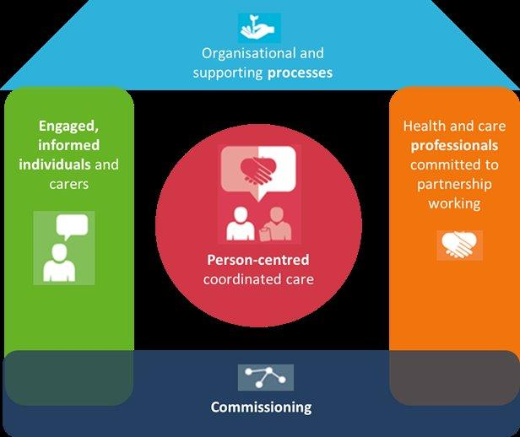
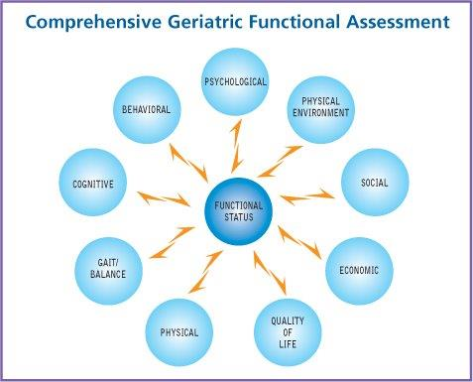
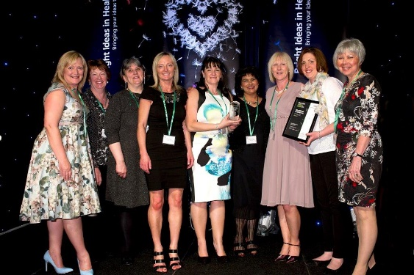
Extending the Practice Team
Workforce
Transformation of Nurse team
Frailty Nurse
Primary Care Navigators
Health & Wellbeing Co-ordinator
Practice Based Occupational Therapist
Practice based Community Matron
Older Peoples Specialist Nurses
Emergency Health Care Plan
Notes:
Collaboration with Community services providers, ccg, acute trust, frailty team, community older peoples consultants
Vol ogs
Age uk

Slide 5
Practice Nursing Structure
Lesley Frater
Nurse Manager
Tracey Mooney
Housebound LTC &LD lead
Gillian Anderson
HCA – LD Lead
Katherine Hardy
Marie Cooper
Vacc & Imms lead
Rita Gill
Alyson Carlysle
HOC/Operational lead
Julie Bray
HAC/PCN
Jayne White
HCA/PCN
Angela Robertson
unlinked care home lead
Karen Smithson
Frailty Unplanned admissions lead
Elizabeth
Barwick

Slide 6

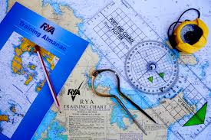

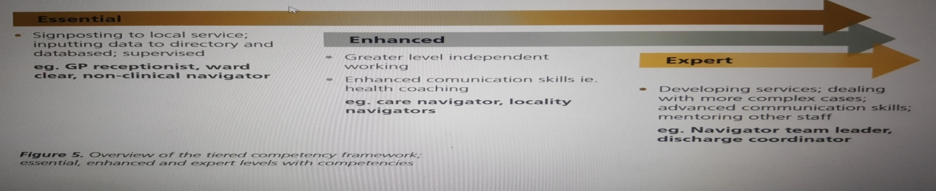
Signposting; Care Navigation; Social Prescribing??

Slide 7
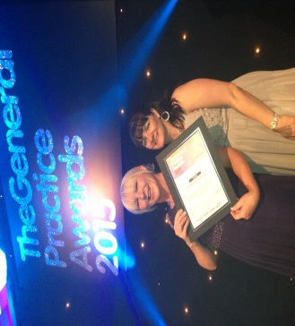
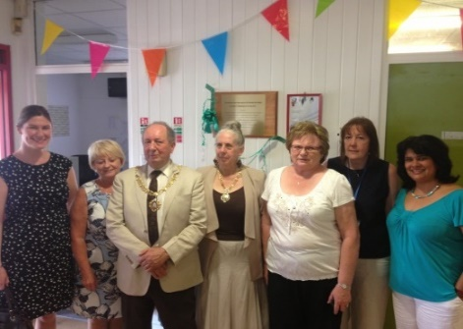
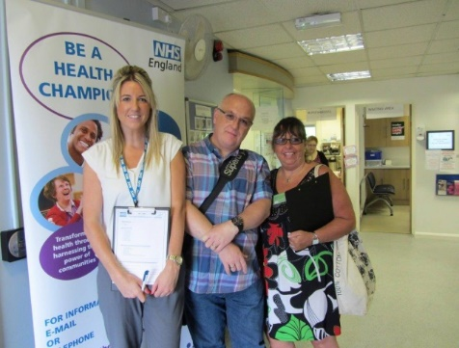
Managing Demand- Through Care Navigation & Social Prescribing
Dementia Screening + 117
Assessment for Dementia +38
Carers Register + 43
Veterans Register + 20
Care Plans +396
NHS Health Checks + 95
Post discharge + 86 none of whom needed a physician as PCN sorted
Reduction in discharge letters suggesting avoided admissions – from 7 to 8 a day to 2-3 a week, within first six months
more effective in ringing patients following emergency admission
less fragmentation
reception managing better
improved communication
less prescription errors
more co-ordinated personalised care
Now Extended to Long Term Conditions/Full Practice Population
Notes:
PCN
Dynamic directory of services
Age uk, gateshead club house,
Older peoples assembly
All organisations that work with people with dementia
Carers organisations
Extended to mental health and year of care
Practice health champions

Slide 8
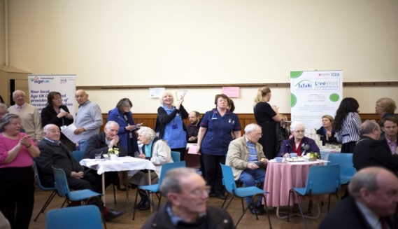
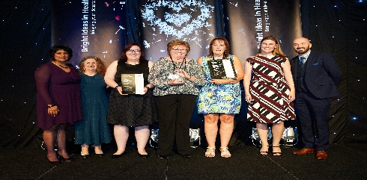
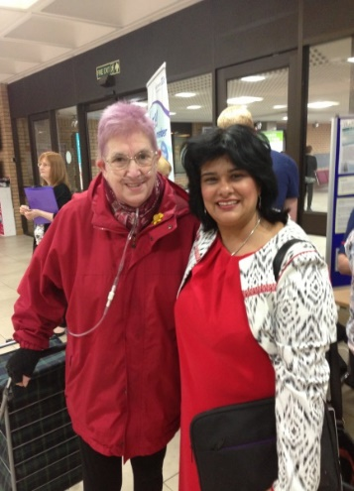
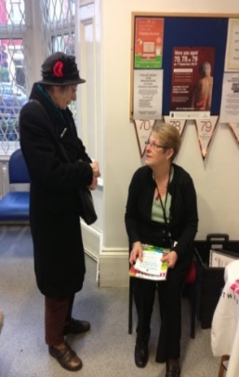
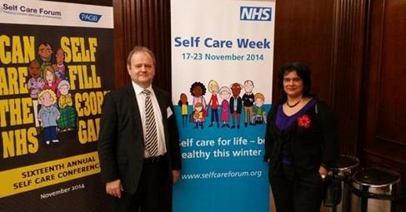
Collaborative Working: Supported Self Help
Year of Care;
Practice Health Champions;
Long term conditions strategy launch tea dance;
Voluntary organisations providing self-help support;
250 people attended & introduced to community based organisations to support them with their long term conditions;
An opportunity to meet with health care professionals in an informal setting to discuss health and wellbeing needs;
Flu fair, to enable supported self-help, 150 people attended;
Several self-help groups, befriending, knit ‘n’ Natter, walking, games groups & link with existing groups in our community.

Slide 9
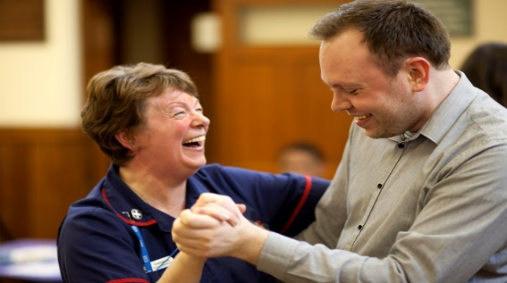
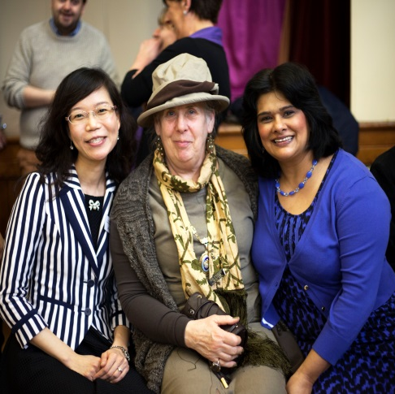
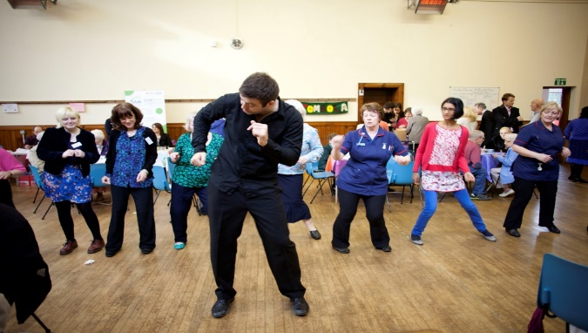
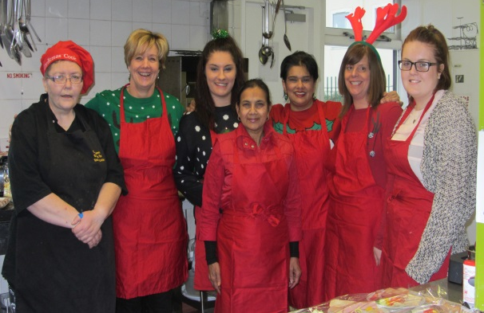
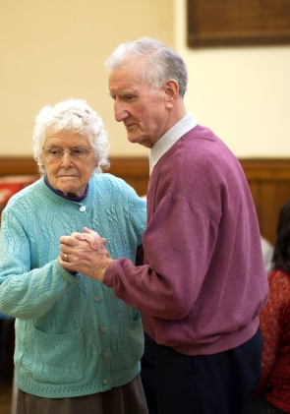
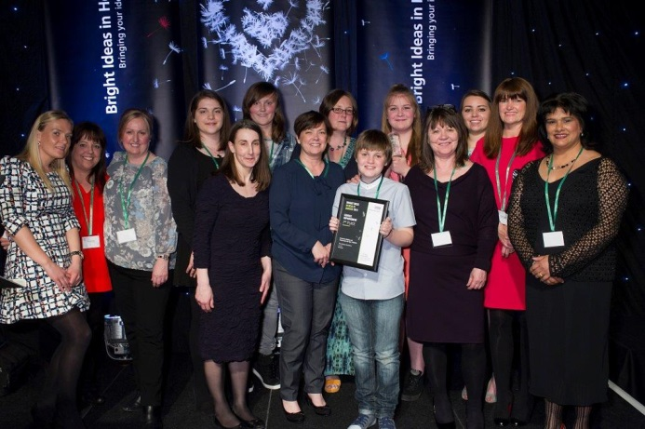
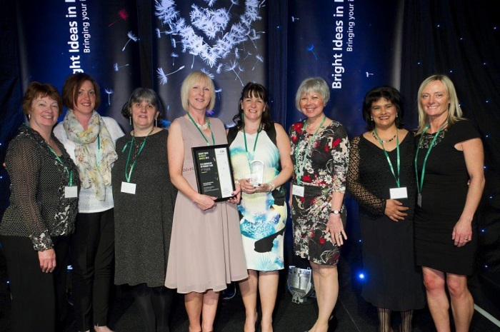

Questions?
We are the change we want to see in 21st Century General Practice
“Whoooooooo hooooooooo ,:) :) :) This is the bestest work place in the world and proud to be a part of it ..... such a good team !”
Julie Bray – PCN
Practice Health Champions Have Broken Down the Berlin Wall Between GP and Patients

